Slide 1
MGM-Project
Telerik academy alpha

Slide 2

Front-end
teamwork assignment

Slide 3
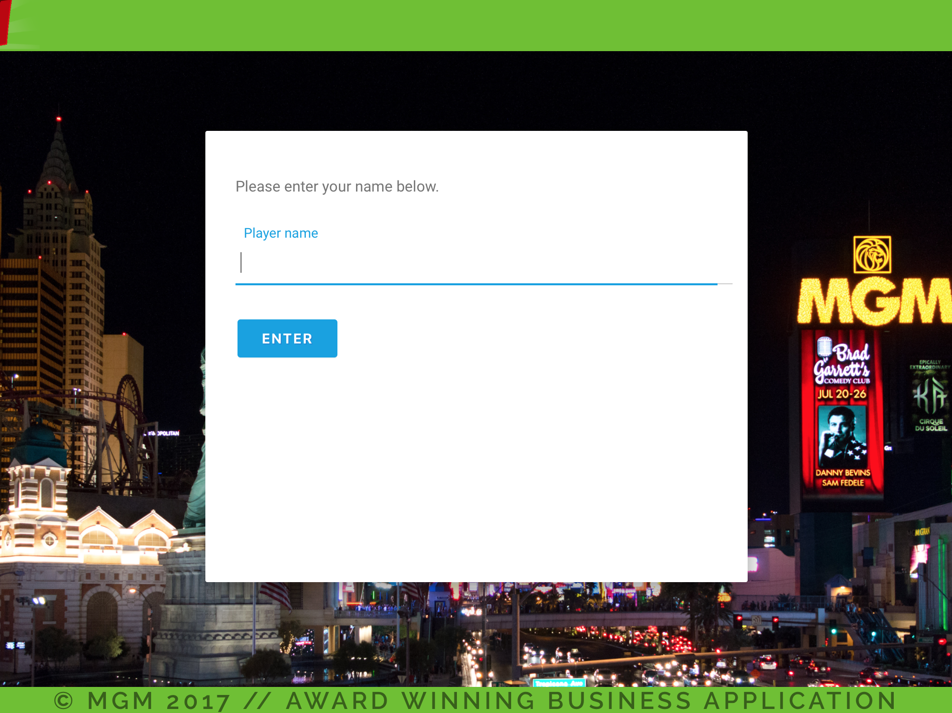
business application
award winning

Slide 4

BLACKJACK
LIVE

Slide 5
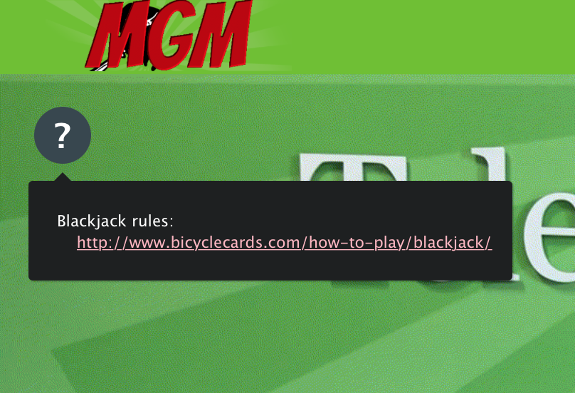
HELP FOR NEW PLAYERS

Slide 6
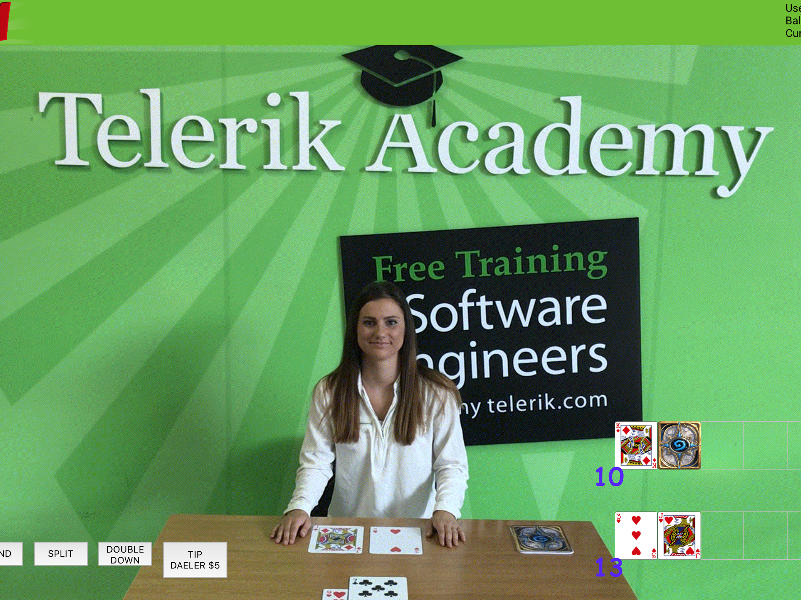
SICK INtERFACE

Slide 7
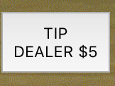
BE NICE!!!

Slide 8

https://github.com/MGM-Project/MGM

